Slide 1
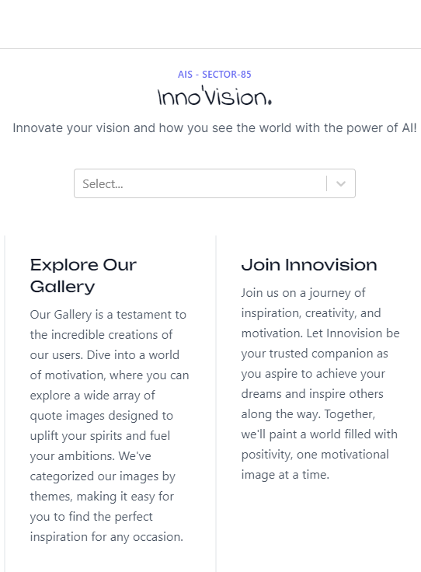

https://innovision.arunnya.com
Innovision: The Quote Generator Bot
Innovision is a quote generator bot created by Arunnya Varma and Himanshu Mukherjee of Aravali International School, Sector-85. It generates motivational, educative, and productive quotes from inspirational sources like Rabindranath Tagore, Nelson Mandela, and Swami Vivekananda.
Team
Aravali International School, Sector-86, GFBD, Haryana
https://github.com/AvIsBeastMC/coding-ds23-2/

Slide 2

Why Use Innovision?
1
Stay motivated 💪
2
Learn something new 📚
Innovision generates motivational quotes that will help you stay inspired and keep pushing your limits.
Innovision generates educative quotes that will expand your knowledge and help you think differently.
3
Boost productivity 🚀
Innovision generates productive quotes that will help you stay focused and improve your efficiency.
Team
Aravali International School, Sector-86, GFBD, Haryana

Slide 3



No More Writers Block 📝
Creative Inspiration
Teambuilding Motivation
Self-Improvement
Innovision generates inspirational quotes that can inspire creativity and help you overcome any writer's block.
Innovision generates quotes that promote teambuilding, helping to keep your team motivated and working together towards a common goal.
Innovision generates quotes that help promote self-improvement - a key component to achieving success in any field.

Slide 4
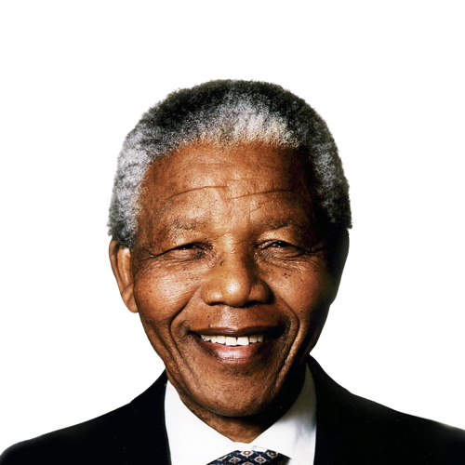
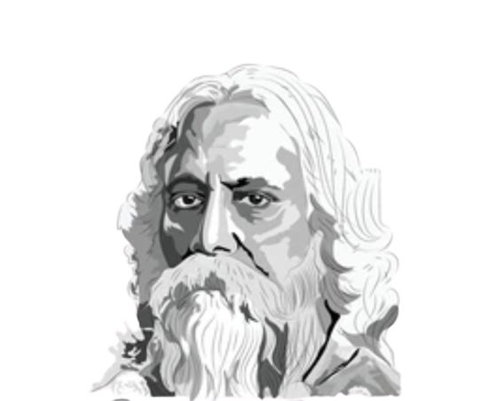
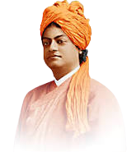
Inspirational Quotes from Great Leaders 🌟
Nelson Mandela 🌍
Mandela's quotes inspire hope and perseverance. He was a key figure in the struggle against apartheid in South Africa.
1
2
3
Rabindranath Tagore
Swami Vivekananda
Tagore's quotes inspire creativity and open-mindedness and were important to the Indian independence movement.
Tagore's quotes inspire creativity and open-mindedness and were important to the Indian independence movement.

Slide 5
Experience the Benefits of Innovision
Inspiration Wherever You Go 🚀
Share the Power 💡
Innovision is accessible from anywhere, so you are always just a quote away from inspiration. Whether traveling for business or leisure, Innovision helps you stay motivated.
Innovision's quotes can be shared with friends, family, and colleagues, allowing everyone to benefit from the positive message contained within.
Personal Development 📚
Empower Your Team 🤝
Innovision's quotes can be used as the foundation for personal development programs. They can provide guidance and inspiration to help you achieve your goals.
Innovision's quotes can be used to promote teamwork and collaboration within your organization. They can be used as icebreakers or conversation starters to help bring your team together.

Slide 6



Stay Inspired with Innovision
Find Quotes That Speak to You
Start Every Day with a Positive Attitude
Realize Your Full Potential
Innovision's quotes can be used to fuel your drive towards success. These productivity-boosting quotes can help you achieve your goals and realize your full potential.
Innovision has a database filled with quotes from a wide range of sources, so you can find the quotes that resonate with you and help push you forward.
Innovision's quotes can help you start every day with a positive and productive attitude. By reading these motivational quotes daily, you can transform your entire outlook on life.

Slide 7
Unlock Your Potential with Innovision
1
Redefine Success
Innovision's quotes can help redefine what success means to you, by making you reevaluate your motivations and ambitions.
Inspire Creativity
2
Innovision's quotes can help inspire creativity and encourage you to think outside the box.
3
Boost Productivity
Innovision's quotes can help boost productivity and make you more efficient in all aspects of your life.
Strengthen Relationships
4
Innovision's quotes can be shared with loved ones, strengthening your relationships with them and encouraging communal growth.

Slide 8

The Future is Bright with Innovision
1
Updates and Improvements 💌
Innovision is constantly updated with fresh content and new features to ensure we continue to make an impact in the future.
2
Inspiration for Generations 🔬
Innovision aims to inspire not just this generation but future ones as well. We hope that this quote generator bot helps to create a more inspired and successful world.

Slide 9








Tech Stack
1
React (NextJS)
React with NextJS has been used for better utilization of the power of JavaScript for flawless UX.
Express.js & MySQL
2
tRPC has been used with Express for Type-safe Frontend- Backend Data Exchange
3
Cloud VPS for Hosting
For faster speed and better management of our network services – Frontend and Backend – we are using an Ubuntu 20.04 VPS as well.
Cloudflare and GoDaddy
4
For faster speed and better management of our network services – Frontend and Backend – we are using an Ubuntu 20.04 VPS as well.
5
Python
Python has been used to prepare quote images based off of the four currently available categories which you can search.

Slide 10
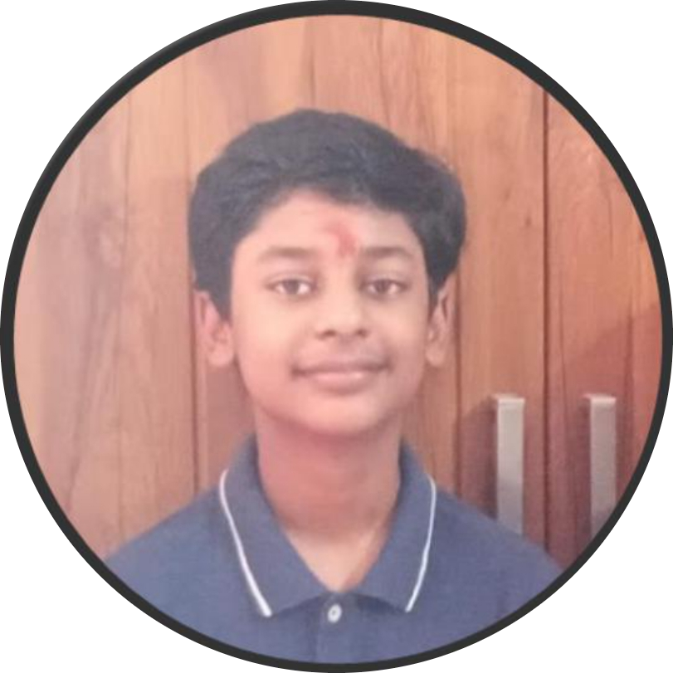
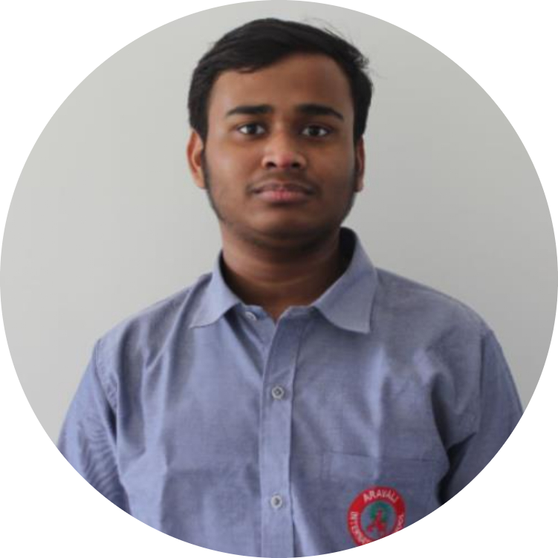
Our Team
1
Arunnya Varma
Developed the entire interface and the backend for the application with AI Models.
Himanshu Mukherjee
2
Contributed to UI-UX. AI Model Training & Helped in Development of Backend Infra.
Team
Aravali International School, Sector-86, GFBD, Haryana

